Slide 1
Device Selection Algorithm for Federated Learning
PROJECT - II
Supervisor:
Dr. Satendra Kumar
Name: Kartik Mouli
Roll No.: 2001CS35

Slide 2
Index
Introduction
Problem Statement
Solution
Experimental Setup
Result and Comparison
Conclusion

Slide 3
Introduction
Importance of Device Selection
The success of Federated Learning hinges on the effective selection of devices participating in the training process.
Optimal device selection impacts the efficiency, convergence speed, and overall performance of federated learning algorithms.

Slide 4
Problem Statement
Diverse Device Characteristics
Devices exhibit variations in Computational Power, Memory Capacity, Cost Efficiency, and Network Latency.
Harmonizing these diverse characteristics for effective collaboration poses a challenge in device selection.
Random selection may overlook the efficient use of device resources, emphasizing the need for strategic, property-aware selection methods.

Slide 5
Solution: A Naive Way
Combinatorial Complexity
The naive approach of considering all possible combinations of devices for collaboration leads to a combinatorial explosion.
Improvement
The improved strategy involves choosing a single device in each iteration, mitigating the combinatorial complexity associated with exhaustive combinations.

Slide 6
Solution: Optimal Approach
Optimization aims to leverage device properties— Computational Power, Memory Capacity, Energy Efficiency, and Network Efficiency —for strategic and efficient model collaboration.
Heuristic based evaluation ensures devices are chosen strategically from sub-set.

Slide 7

Solution: Optimal Approach
Heuristic Equation
f1(i) - computational power of idevice
f2(i) - memory capacity of ith device
f3(i) - energy efficiency of ith device
f4(i) - network efficiency of ith device
|S(n)| - number of selected devices
α, β, γ, δ: Parameters

Slide 8

Optimization Objective
f(Φ) - Accuracy of Global federated learning model
H - Heuristic function
Objective: Maximize the combined value of accuracy (A) and
heuristic (H).

Slide 9
Experimental Setup
Computational Power: The device's capability to perform computations and execute tasks efficiently.
Memory Capacity: The amount of data the device can store and access for processing.
Energy Efficiency: The device's ability to perform tasks while conserving energy and minimizing power consumption.
Network Efficiency: The effectiveness of the device in managing and utilizing network resources for communication and data transfer.

Slide 10
Experimental Setup
In the experimental setup, our focus lies in utilizing the IRIS dataset distributed across 30 edge devices.
We can see that device properties differ in Computational Power, Memory Capacity, Energy Efficiency, Network Efficiency.
In doing so, we must account for the fundamental tradeoff between resource utilization and accuracy metrics.

Slide 11
Dataset and Machine Learning Model
The Iris dataset is a classic machine learning dataset containing samples of iris flowers, each with four features: sepal length, sepal width, petal length, and petal width. The goal is to classify each sample into one of three species: setosa, versicolor, or virginica.
The model comprises an input layer with 4 neurons, a hidden layer with 10 neurons utilizing ReLU activation, and an output layer with 3 neurons employing softmax activation for class probabilities.

Slide 12
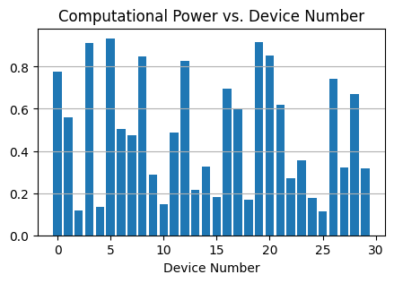
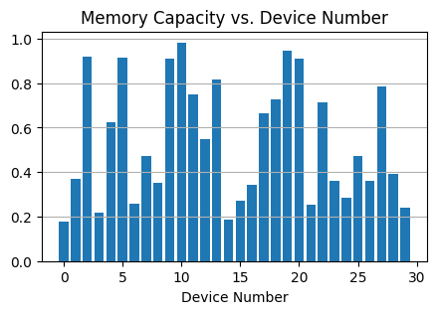
Experimental Setup

Slide 13
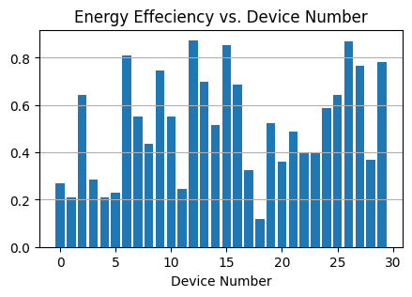
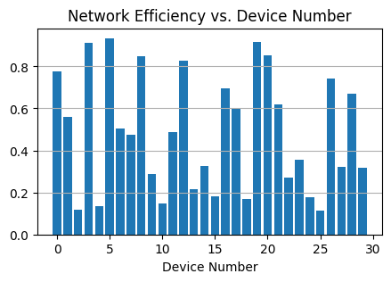
Experimental Setup

Slide 14
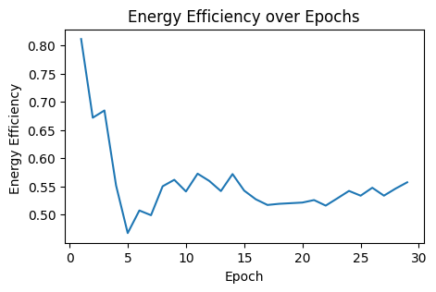
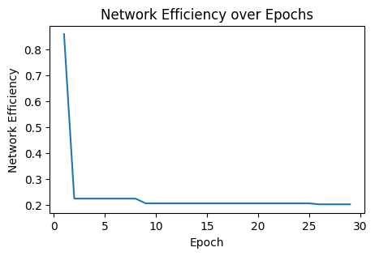
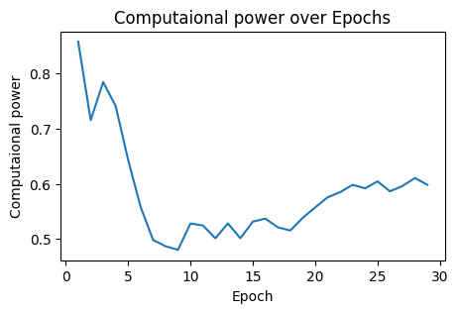
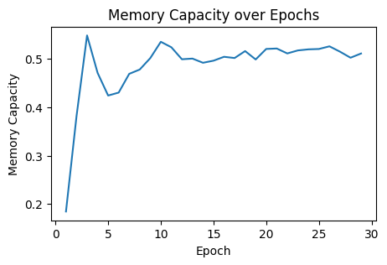
Existing Approach

Slide 15
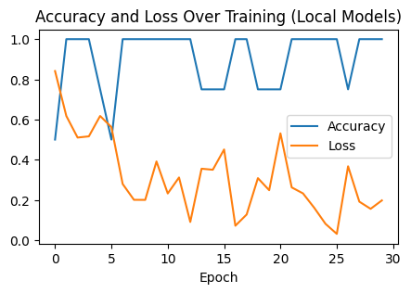
Performance Evaluation
The Global Model achieves accuracy of 90%.

Slide 16
Proposed Optimized Approach
The iterative improvement method tries to improve the device set by including devices one by one.
Using other ML models and dataset can differ the accuracy of all the considered scenarios, but their relative performance will remain the same.

Slide 17
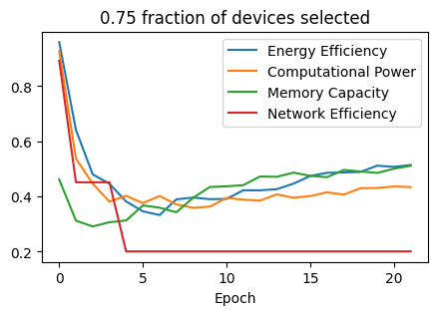
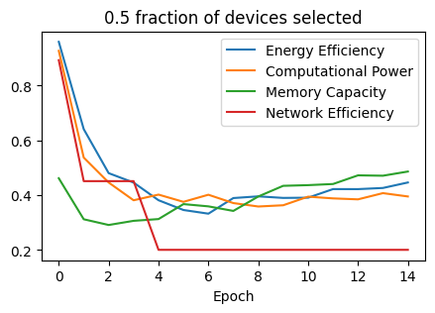
Optimized Approach
For 0.5 fraction of selected devices the accuracy is ~90%
For 0.75 fraction of selected devices the accuracy is ~92%

Slide 18
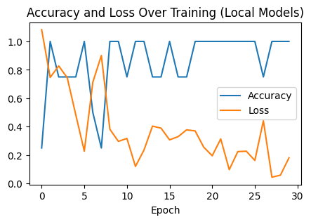
Performance
The Global Model achieves accuracy of ~93.33%
If, all devices are selected.

Slide 19
Conclusion
The federated learning increases the privacy of raw data by sharing only the ML model parameters.
The selection of devices is made so that the resource requirement reduces while the optimal performance of the global model is attained.

Slide 20

Thank You

